Slide 1
Fundamentals of Computing

Slide 2
Session 6: Fundamentals of Computing
Programming concepts
Introduction
Program Structure
Variable Declaration
The Boolean Operators
Comparison Operators
Combining Boolean and Comparison Operators
Conditional Statements (IF..THEN..ELSE)
Iterative Constructs (Loops)

Slide 3
Programing Concepts
Computer Programing Languages can be classed into three (3) different categories of computer languages: Machine language, Assemble language and High-Level language
Machine Language
Native language of a particular computer
Instructions are in Binary form ( 1s and 0s)
All language are translated to machine language
Example:
X = X + 1 mathematical notation
1010 0001 1110 0110 0000 0001
0000 0011 0000 0110 0000 0001 0000 binary notation
0000 1010 0011 1110 0110 0000 0001

Slide 4
Programing Concepts (cont…)
Assembly Language
uses English-like abbreviations to represent operations performed on the data.
must be translated into machine language with the help of the special program called an assembler.
Example:
MOV AX, [01E6]
ADD AX, 0001
MOV [01E6], AX
increasing the value of the variable by 1 as well. This example is also specific to an Intel processor.

Slide 5
Programing Concepts (cont…)
High-Level Language
uses English-like instructions and common mathematical notations.
allow programmers to perform complicated calculations with a single instruction
easier to read and understand than machine and assembly languages
not as time-consuming to create a program in high-level language as it is in machine or assembly language
Example:
variable := variable + 1;

Slide 6
Introduction
Computer Programs (softwares) and Languages:
set of instruction executed by a computer to perform a task
non physical part of the computer but very important
There are different types of programs developed from different types of computer language
Two different types of Softwares:
System software
Application Software
Softwares are developed from different languages

Slide 7
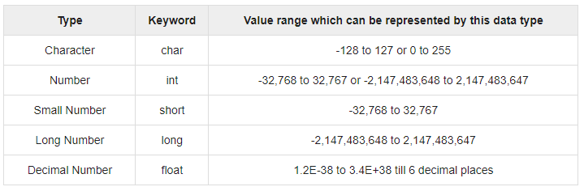
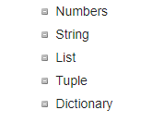
Program Structure
Definition:
A collection of different datatypes, variables, grouped together under a single name.
Examples of Different datatypes:
C, C++, Java datatypes Python Datatypes

Slide 8
Program Structure (cont…)

